Slide 1

Chapter 4
Defining Your Own Classes
Part 1
Animated Version

Slide 2
Objectives
After you have read and studied this chapter, you should be able to
    Define a class with multiple methods and data members
    Differentiate the local and instance variables
    Define and use value-returning methods
    Distinguish private and public methods
    Distinguish private and public data members
    Pass both primitive data and objects to a method

Slide 3
Why Programmer-Defined Classes
Using just the String, GregorianCalendar, JFrame and other standard classes will not meet all of our needs. We need to be able to define our own classes customized for our applications.
Learning how to define our own classes is the first step toward mastering the skills necessary in building large programs.
Classes we define ourselves are called programmer-defined classes.
Notes:
The sample application programs we have written so far included only one class, the main class of the program. And the main class contained only one method, the main method. When we review the sample programs developed so far, we note two key characteristics:
The programs included only one class, the main class of the program.
The main class contained only one method, the main method. From this main method, we used objects and classes from the standard packages such as javax.swing and java.util
.
Such organization works only for small programs. In order to manage complexity of large programs, it is best to define instantiable classes.

Slide 4
First Example: Using the Bicycle Class
class BicycleRegistration {
public static void main(String[] args) {
Bicycle bike1, bike2;
String owner1, owner2;
bike1 = new Bicycle( ); //Create and assign values to bike1
bike1.setOwnerName("Adam Smith");
bike2 = new Bicycle( ); //Create and assign values to bike2
bike2.setOwnerName("Ben Jones");
owner1 = bike1.getOwnerName( ); //Output the information
owner2 = bike2.getOwnerName( );
System.out.println(owner1 + " owns a bicycle.");
System.out.println(owner2 + " also owns a bicycle.");
}
}
Notes:
This sample program shows the main class BicycleRegistration is using the Bicycle class. This Bicycle class is not part of any standard packages. It is something we (or other programmers) have to define ourselves.

Slide 5
The Definition of the Bicycle Class
class Bicycle {
// Data Member
private String ownerName;
//Constructor: Initialzes the data member
public Bicycle( ) {
ownerName = "Unknown";
}
//Returns the name of this bicycle's owner
public String getOwnerName( ) {
return ownerName;
}
//Assigns the name of this bicycle's owner
public void setOwnerName(String name) {
ownerName = name;
}
}

Slide 6
Multiple Instances
Once the Bicycle class is defined, we can create multiple instances.
bike1
bike2
Bicycle bike1, bike2;
bike1 = new Bicycle( );
: Bicycle
: Bicycle
bike1.setOwnerName("Adam Smith");
ownerName
ownerName
bike2 = new Bicycle( );
“Adam Smith”
“Ben Jones”
bike2.setOwnerName("Ben Jones");
Sample Code
Notes:
Once a class is defined, we can create multiple instances of the class as shown by this example. Notice how all the instances have their own copy of data members.

Slide 7
The Program Structure and Source Files
BicycleRegistration
Bicycle
There are two source files. Each class definition is stored in a separate file.
BicycleRegistration.java
Bicycle.java
To run the program: 1. javac Bicycle.java (compile)
2. javac BicycleRegistration.java (compile)
3. java BicycleRegistration (run)

Slide 8
Class Diagram for Bicycle
Bicycle
Bicycle( )
Method Listing
We list the name and the data type of an argument passed to the method.
getOwnerName( )
setOwnerName(String)
Notes:
We introduced the icon to represent a class in Chapter 2. We extend that icon to include the list of methods for the class. In listing a method, we indicate the data type of the arguments passed to the method.

Slide 9
Template for Class Definition
Import Statements
Class Comment
class
{
Class Name
Data Members
Methods
(incl. Constructor)
}
Notes:
This is the template we use when creating programmer-defined classes.

Slide 10
Data Member Declaration
  <modifiers> <data type> <name> ;
Modifiers
Data Type
Name
  private String ownerName ;
Note: There’s only one modifier in this example.

Slide 11
Method Declaration
  <modifier> <return type> <method name> ( <parameters> ){
  <statements>
  }
Modifier
Return Type
Method Name
Parameter
  public void setOwnerName ( String name ) {
  ownerName = name;
  }
Statements

Slide 12
Constructor
A constructor is a special method that is executed when a new instance of the class is created.
public <class name> ( <parameters> ){
<statements>
}
Modifier
Class Name
Parameter
  public Bicycle ( ) {
  ownerName = "Unassigned";
  }
Statements

Slide 13
Second Example: Using Bicycle and Account
class SecondMain {
//This sample program uses both the Bicycle and Account classes
public static void main(String[] args) {
Bicycle bike;
Account acct;
String myName = "Jon Java";
bike = new Bicycle( );
bike.setOwnerName(myName);
acct = new Account( );
acct.setOwnerName(myName);
acct.setInitialBalance(250.00);
acct.add(25.00);
acct.deduct(50);
//Output some information
System.out.println(bike.getOwnerName() + " owns a bicycle and");
System.out.println("has $ " + acct.getCurrentBalance() + " left in the bank");
}
}
Notes:
This sample code shows a program that uses two programmer-defined classes Bicycle and Account. The same string value is passed as the name of the owner for both objects.

Slide 14
The Account Class
class Account {
private String ownerName;
private double balance;
public Account( ) {
ownerName = "Unassigned";
balance = 0.0;
}
public void add(double amt) {
balance = balance + amt;
}
public void deduct(double amt) {
balance = balance - amt;
}
public double getCurrentBalance( ) {
return balance;
}
public String getOwnerName( ) {
return ownerName;
}
public void setInitialBalance
(double bal) {
balance = bal;
}
public void setOwnerName
(String name) {
ownerName = name;
}
}
Page 1
Page 2

Slide 15
The Program Structure for SecondMain
Bicycle
SecondMain
Account
SecondMain.java
Bicycle.java
Account.java
To run the program: 1. javac Bicycle.java (compile)
2. javac Account.java (compile)
2. javac SecondMain.java (compile)
3. java SecondMain (run)
Note: You only need to compile the class once. Recompile only when you made changes in the code.

Slide 16
Arguments and Parameters
class Sample {
public static void
main(String[] arg) {
Account acct = new Account();
. . .
acct.add(400);
. . .
}
. . .
}
parameter
class Account {
. . .
public void add(double amt) {
balance = balance + amt;
}
. . .
}
argument
An argument is a value we pass to a method
A parameter is a placeholder in the called method to hold the value of the passed argument.

Slide 17
Matching Arguments and Parameters
The number or arguments and the parameters must be the same
Demo demo = new Demo( );
int i = 5; int k = 14;
demo.compute(i, k, 20);
3 arguments
Arguments and parameters are paired left to right
Passing Side
class Demo {
public void compute(int i, int j, double x) {
. . .
}
}
The matched pair must be assignment-compatible (e.g. you cannot pass a double argument to a int parameter)
3 parameters
Receiving Side
Notes:
The following calls are valid
int i, k, m;
i = 12; k = 10; m = 14;
demo.compute(3, 4, 5.5);
demo.compute(i, k, m);
demo.compute(m, 20, 40);
The following calls are not valid
demo.compute(2, 4);
demo.compute(14.0, 2, 3.0);

Slide 18
Memory Allocation
Separate memory space is allocated for the receiving method.
i
5
i
5
k
14
j
14
20
x
20.0
Values of arguments are passed into memory allocated for parameters.
Passing Side
Receiving Side
Literal constant
has no name
Notes:
The following calls are valid
int i, k, m;
i = 12; k = 10; m = 14;
demo.compute(3, 4, 5.5);
demo.compute(i, k, m);
demo.compute(m, 20, 40);
The following calls are not valid
demo.compute(2, 4);
demo.compute(14.0, 2, 3.0);

Slide 19
Passing Objects to a Method
As we can pass int and double values, we can also pass an object to a method.
When we pass an object, we are actually passing the reference (name) of an object
  it means a duplicate of an object is NOT created in the called method

Slide 20
Passing a Student Object
1
LibraryCard card2;
card2 = new LibraryCard();
card2.setOwner(student);
student
st
card2
Passing Side
1
2
class LibraryCard {
private Student owner;
public void setOwner(Student st) {
owner = st;
}
}
2
: LibraryCard
: Student
owner
name
Receiving Side
“Jon Java”
borrowCnt
email
1
Argument is passed
0
“jj@javauniv.edu”
2
Value is assigned to the
data member
State of Memory

Slide 21
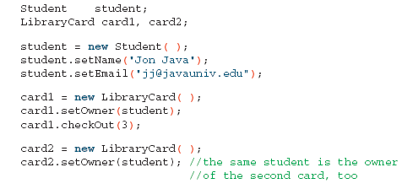
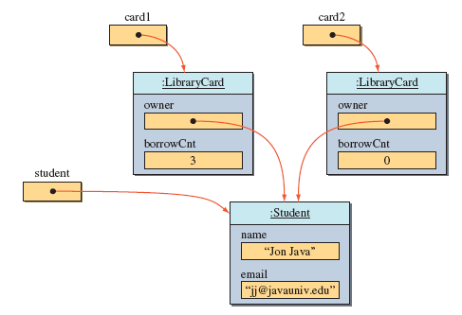
Sharing an Object
We pass the same Student object to card1 and card2
Since we are actually passing a reference to the same object, it results in the owner of two LibraryCard objects pointing to the same Student object

Slide 22
Sharing an Object
We pass the same Student object to card1 and card2
Since we are actually passing a reference to the same object, it results in owner of two LibraryCard objects pointing to the same Student object

Slide 23
Information Hiding and Visibility Modifiers
The modifiers public and private designate the accessibility of data members and methods.
If a class component (data member or method) is declared private, client classes cannot access it.
If a class component is declared public, client classes can access it.
Internal details of a class are declared private and hidden from the clients. This is information hiding.
Notes:
The visibility modifiers dictate the accessibility of class components by the clients. Anything that is considered as internal details should be declared as private and hidden from the clients. For example, exactly how a MobileRobot moves is an internal detail. All the client cares is that a mobile robot is set in motion when its method move is called.
Public methods of a class determines the behavior of its instances. Internal details are implemented by private methods and private data members.

Slide 24
Accessibility Example
  …
  Service obj = new Service();
  obj.memberOne = 10;
  obj.memberTwo = 20;
  obj.doOne();
  obj.doTwo();
  …
  class Service {
  public int memberOne;
  private int memberTwo;
  public void doOne() {
  …
  }
  private void doTwo() {
  …
  }
  }
Client
Service
Notes:
This is a simple example of public and private modifiers. See how the client can access the public data member and method.

Slide 25
Data Members Should Be private
Data members are the implementation details of the class, so they should be invisible to the clients. Declare them private .
Exception: Constants can (should) be declared public if they are meant to be used directly by the outside methods.
Notes:
If a data member is declared public then a client can make changes directly that can affect the internal operation adversely. Hide the component that needs to be hidden to maintain the integrity of the class. Although class constants should be declared public when direct access to them is desired, please note that once a constant is declared public, its name cannot be changed without affecting the client code that made a direct access. So it is important to derive a good name that you don’t have to come back and change it.

Slide 26
Guideline for Visibility Modifiers
Guidelines in determining the visibility of data members and methods:
  Declare the class and instance variables private.
  Declare the class and instance methods private if they are used only by the other methods in the same class.
  Declare the class constants public if you want to make their values directly readable by the client programs. If the class constants are used for internal purposes only, then declare them private.

Slide 27
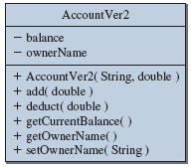
Diagram Notation for Visibility
public – plus symbol (+)
private – minus symbol (-)
Notes:
If we include both the private and public components, then we use the plus symbol for public and the minus symbol for private.

Slide 28
Class Constants
In Chapter 3, we introduced the use of constants.
We illustrate the use of constants in programmer-defined service classes here.
Remember, the use of constants
  provides a meaningful description of what the values stand for. number = UNDEFINED; is more meaningful than number = -1;
  provides easier program maintenance. We only need to change the value in the constant declaration instead of locating all occurrences of the same value in the program code
Notes:
Suppose we have a constant declaration
private final static int MIN_NUM = 10;
and this constant is used in 20 different places in the code. When we need to change this value to 50, we only need to change the declaration. What happens if we didn’t declare this constant? We have to hunt for all 20 occurrences of the value 10 and change them to 20. What if you missed one or two of them? The program would not work at all or produce a wrong result.
Easy, just use global replace command? You have to be very careful in using global replace. What happens if there’s a value of 10 in the code, but this 10 refers to a different use (say, one set of occurrences is referring to the weight, while others referring to the age)? If you globally replaced all occurrences of 10, again your program would stop working correctly.

Slide 29
A Sample Use of Constants
import java.util.Random;
class Die {
private static final int MAX_NUMBER = 6;
private static final int MIN_NUMBER = 1;
private static final int NO_NUMBER = 0;
private int number;
private Random random;
public Dice( ) {
random = new Random();
number = NO_NUMBER;
}
//Rolls the dice
public void roll( ) {
number = random.nextInt(MAX_NUMBER - MIN_NUMBER + 1) + MIN_NUMBER;
}
//Returns the number on this dice
public int getNumber( ) {
return number;
}
}

Slide 30
Local Variables
Local variables are declared within a method declaration and used for temporary services, such as storing intermediate computation results.
public double convert(int num) {
double result;
result = Math.sqrt(num * num);
return result;
}
local variable

Slide 31
Local, Parameter & Data Member
An identifier appearing inside a method can be a local variable, a parameter, or a data member.
The rules are
  If there’s a matching local variable declaration or a parameter, then the identifier refers to the local variable or the parameter.
  Otherwise, if there’s a matching data member declaration, then the identifier refers to the data member.
  Otherwise, it is an error because there’s no matching declaration.

Slide 32
Sample Matching
class MusicCD {
private String artist;
private String title;
private String id;
public MusicCD(String name1, String name2) {
String ident;
artist = name1;
title = name2;
ident = artist.substring(0,2) + "-" +
title.substring(0,9);
id = ident;
}
...
}
Notes:
Here’s an example on how the matching declaration is found.

Slide 33
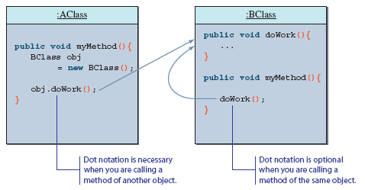
Calling Methods of the Same Class
So far, we have been calling a method of another class (object).
It is possible to call method of a class from another method of the same class.
  in this case, we simply refer to a method without dot notation

Slide 34
Changing Any Class to a Main Class
Any class can be set to be a main class.
All you have to do is to include the main method.
    class Bicycle {
    //definition of the class as shown before comes here
    //The main method that shows a sample
    //use of the Bicycle class
    public static void main(String[] args) {
    Bicycle myBike;
    myBike = new Bicycle( );
myBike.setOwnerName("Jon Java");
    System.out.println(myBike.getOwnerName() + "owns a bicycle");
    }
    }
Notes:
When we create a program, we must designate one class as the program’s main class. The designated main class must include the main method. This requirement does not prohibit us to include the main method to other classes in the program. Any class can include the main method. As long as the one we designate as the main class includes the main method, all other classes may or may not include the main method.
Being able to include the main method in any class allows to provide a sample use of the class in the class definition itself, which makes the source management easier.

Slide 35
Main Point
In the OO paradigm, the focus shifts to mapping real world objects and dynamics to software objects and behavior; this parallel structure has proven to be more robust, less error prone, more scalable, and more cost-effective. In SCI we see that a more profound paradigm is discovered when the point of reference moves from the individual to the unbounded level.

Slide 36
Connecting the Parts of Knowledge With the Wholeness of Knowledge
Object identity and identifying with unboundedness
A Java class specifies the type of data and the implementation of the methods that any of its instances will have.
Every object has not only state and behavior, but also identity, so that two objects of the same type and having the same state can be distinguished.
Transcendental Consciousness: TC is the identity of each individual, located at the source of thought.
Wholeness moving within itself: In Unity Consciousness, one's unbounded identity is recognized to be the final truth about every object. All objects are seen to have the same ultimate identity, even though differences on the surface still remain.

Slide 37
Problem Statement
Problem statement:
Write a loan calculator program that computes both monthly and total payments for a given loan amount, annual interest rate, and loan period.

Slide 38
Overall Plan
Tasks:
  Get three input values: loanAmount, interestRate, and loanPeriod.
  Compute the monthly and total payments.
  Output the results.
Notes:
As a part of the overall plan, we begin by identifying the main tasks for the program. Notice this program follows the universal pattern of computer programs, namely, the pattern of input, computation, and output.

Slide 39
Required Classes
LoanCalculator
Console
Loan
PrintStream
input
computation
output
Notes:
Given the tasks identified in the overall program flow, we need to find suitable classes and objects to carry out the tasks. For this program, we will use the Math class for computation, JOptionPane for input, and System.out (PrintStream) for output as we did in Chapter 3 sample development. Unlike Chapter 3 where all tasks were carried out inside the main method, we now delegate the tasks to two classes. The first is the LoanCalculator class that controls other objects, and the second is the Loan class that represents a single loan and provides methods that pertain to payment computation.

Slide 40
Development Steps
We will develop this program in five steps:
  Start with the main class LoanCalculator. Define a temporary placeholder Loan class.
  Implement the input routine to accept three input values.
  Implement the output routine to display the results.
  Implement the computation routine to compute the monthly and total payments.
  Finalize the program.
Notes:
We begin with the skeleton code for the top controller class LoanCalculator and the service, or logic, class Loan. Because all of the major tasks are now handled by the LoanCalculator and Loan classes, the main method is very simply to create an instance of the LoanCalculator class and run it.

Slide 41
Step 1 Design
The methods of the LoanCalculator class
Method | Visibility | Purpose
start | public | Starts the loan calcution. Calls other methods
computePayment | private | Give three parameters, compute the monthly and total payments
describeProgram | private | Displays a short description of a program
displayOutput | private | Displays the output
getInput | private | Gets three input values
Notes:
We design how the main class (client) will interact with the controller class LoanCalculator. Instead of requiring the client to call the correct methods of LoanCalculator in the correct order, we will simplify the interaction by requiring the client to call just one method named start.

Slide 42
Step 1 Code
    Directory: Chapter4/Step1
    Source Files:
    LoanCalculator.java
    Loan.java
Program source file is too big to list here. From now on, we ask
you to view the source files using your Java IDE.
Notes:
Please use your Java IDE to view the source files and run the program.

Slide 43
Step 1 Test
In the testing phase, we run the program multiple times and verify that we get the following output
inside describeProgram
inside getInput
inside computePayment
inside displayOutput
Notes:
Run the program and verify that you get the same result.

Slide 44
Step 2 Design
Design the input routines
  LoanCalculator will handle the user interaction of prompting and getting three input values
  LoanCalculator calls the setAmount, setRate and setPeriod of a Loan object.

Slide 45
Step 2 Code
    Directory: Chapter4/Step2
    Source Files:
    LoanCalculator.java
    Loan.java

Slide 46
Step 2 Test
We run the program numerous times with different input values
Check the correctness of input values by echo printing
System.out.println("Loan Amount: $"
+ loan.getAmount());
System.out.println("Annual Interest Rate:"
+ loan.getRate() + "%");
System.out.println("Loan Period (years):"
+ loan.getPeriod());

Slide 47
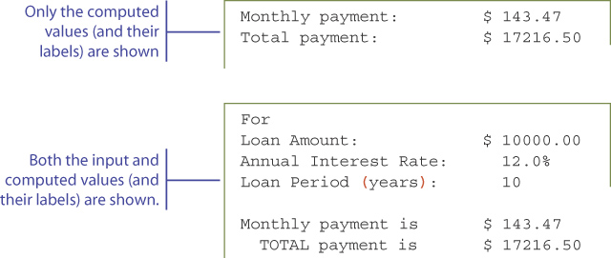
Step 3 Design
We will implement the displayOutput method.
We will reuse the same design we adopted in Chapter 3 sample development.
Notes:
The design of the output layout is the same as the one we used in Chapter 3 sample development. The only difference is the location of code for performing the output. Instead of placing them in the main method, it is now handled by the LoanCalculator class.

Slide 48
Step 3 Code
    Directory: Chapter4/Step3
    Source Files:
    LoanCalculator.java
    Loan.java
Notes:
Run the program and check the output display format.

Slide 49
Step 3 Test
We run the program numerous times with different input values and check the output display format.
Adjust the formatting as appropriate
Notes:
The output format that may look nice may look horrible for a different set of input values, so don’t forget to test the program with many different input values.

Slide 50
Step 4 Design
Two methods getMonthlyPayment and getTotalPayment are defined for the Loan class
We will implement them so that they work independent of each other.
It is considered a poor design if the clients must call getMonthlyPayment before calling getTotalPayment.
Notes:
The getMonthlyPayment method sets the data member monthlyPayment. So one may think (incorrectly) that getTotalPayment can be defined as
public double getTotalPayment( ) {
return monthlyPayment * numberOfPayments;
}
This is wrong because it puts unnecessary burden on the client programmers to remember to call getMonthlyPayment first. The getTotalPayment should work correctly regardless of getMonthlyPayment being called prior to it or not.
We will implement them as two independent methods without any requirements in the order of calling them.

Slide 51
Step 4 Code
    Directory: Chapter4/Step4
    Source Files:
    LoanCalculator.java
    Loan.java

Slide 52
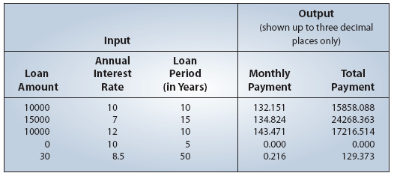
Step 4 Test
We run the program numerous times with different types of input values and check the results.
Notes:
We will use the same test data used in Chapter 3 sample development.

Slide 53
Step 5: Finalize
We will implement the describeProgram method
We will format the monthly and total payments to two decimal places using DecimalFormat.
    Directory: Chapter4/Step5
    Source Files (final version):
    LoanCalculator.java
    Loan.java
Notes:
Make sure to test the program fully one more time after the changes/additions in this step is done.

